Slide 1

Tutorial: Fluent CFD
Eneko Lazpita
ModelFLOWs
Cardiac

Slide 2
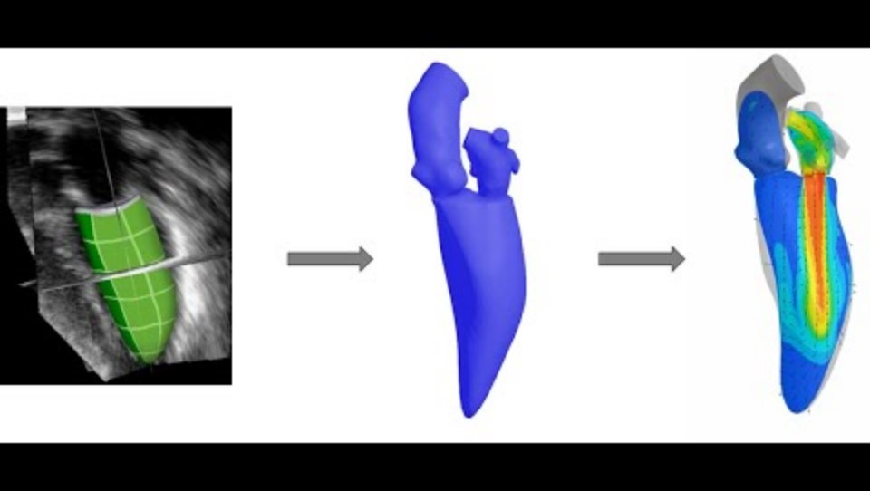








Prof. Michael Neidlin
https://youtu.be/C1O20YvkCJs
https://github.com/mneidlin/movingmesh
https://doi.org/10.5281/zenodo.8233365 https://doi.org/10.1002/eng2.13041
ModelFLOWs
Cardiac

Slide 3
Step 0: Prerequisites
Python and Spyder: install pip, numpy wheel, matplotlib, scipy.
Ansys Workbench, SpaceClaim, Meshing, Fluent, CFD-Post
STL files of the ventricle evolution. (Go to Geometry Preprocessing tutorial)
Step 0.1: Load given workbench file
Setup of this tutorial done.
Very important to avoid negative volumes when loading mesh.
ModelFLOWs
Cardiac

Slide 4
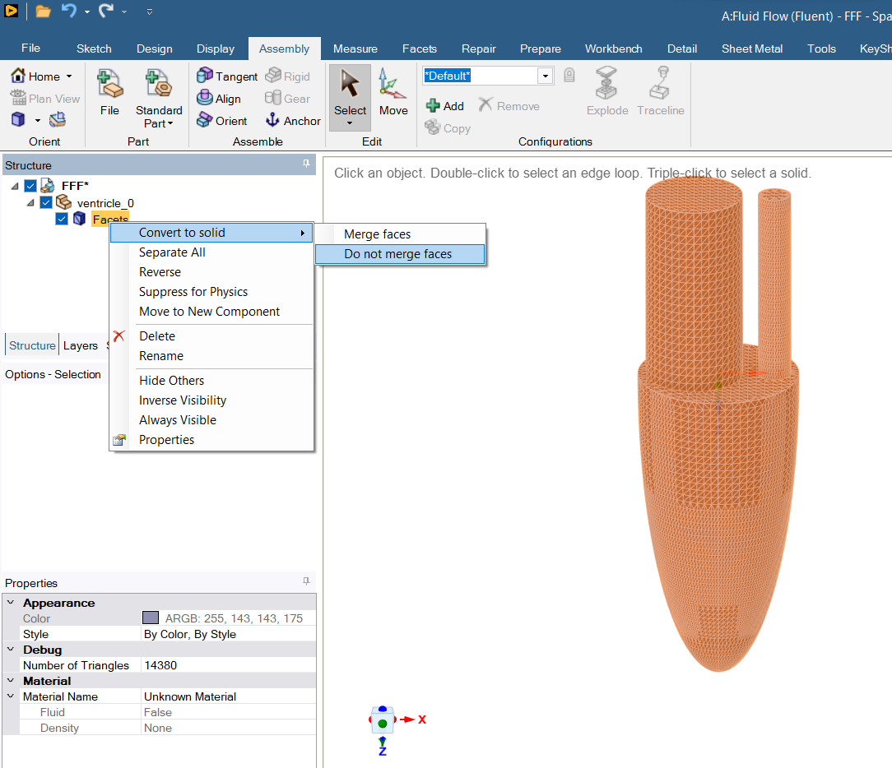
Step 1.1: Load Geometry
Reset Geometry
Open SpaceClaim
Load initial geometry using Assembly → File → ventricle_0.stl
Make sure you set the STL units in the correct one for your geometry when loading (milimeters in ours)
Right click in Facets → Convert to solid → Do not merge faces
ModelFLOWs
Cardiac
Geometry & Mesh

Slide 5
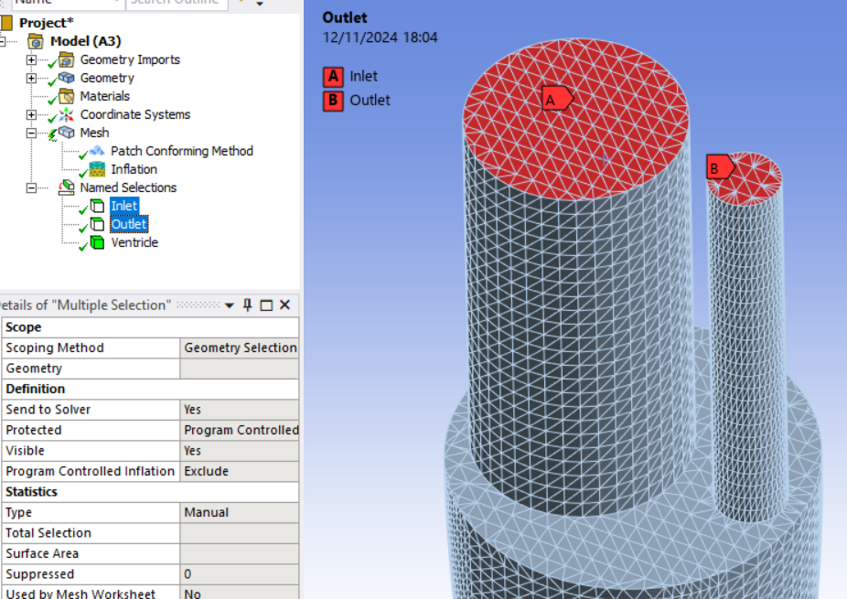
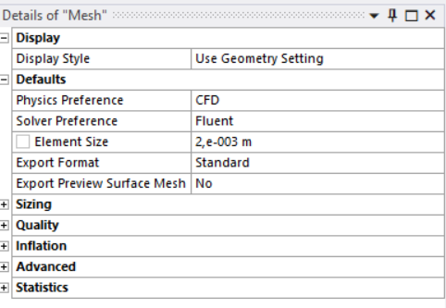
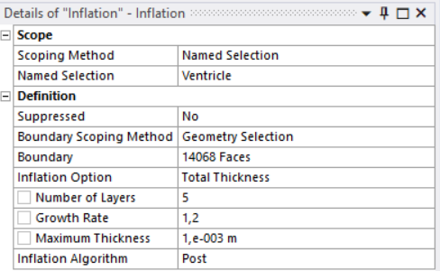
Step 1.2: Meshing
Update Upstream Components and Edit mesh.
Define Boundaries with Named Selections: Inlet, Outlet, Ventricle.
Define Element Size as your mesh base size.
Tetrahedron → Patch Comforming Method necessary for our setup.
(Optional) Inflation: To include prism layers (Post meshing necessary).
ModelFLOWs
Cardiac
Geometry & Mesh

Slide 6
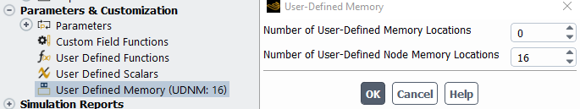
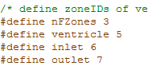
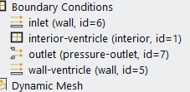

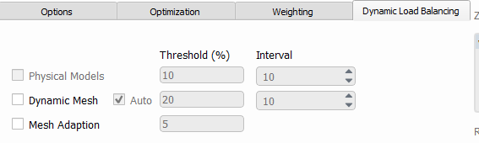
Step 2.1: Loading User Defined Functions
Start Fluent: Double precision and desired processes.
Change solver processes: Parameters & Customization → User-defined Memory
Check and adjust the zone IDs of the outer walls (here: Inlet, outlet and wall-ventricle) in the UDF (udf_exPts.c)
Parameters & Customization → User Defined Functions → Manage
Unload libudf
Copy Necessary Files to Fluent directory
Parameters & Customization → User Defined Functions → Compiled
Add... (udf_exeDynMesh.c; edf_exPts.c; BC_profiles.c)
Use Built-In Compiler → Build → Load
Parallel → Partition/Load Balance → Dynamic Mesh
ModelFLOWs
Cardiac
Simulation Setup

Slide 7
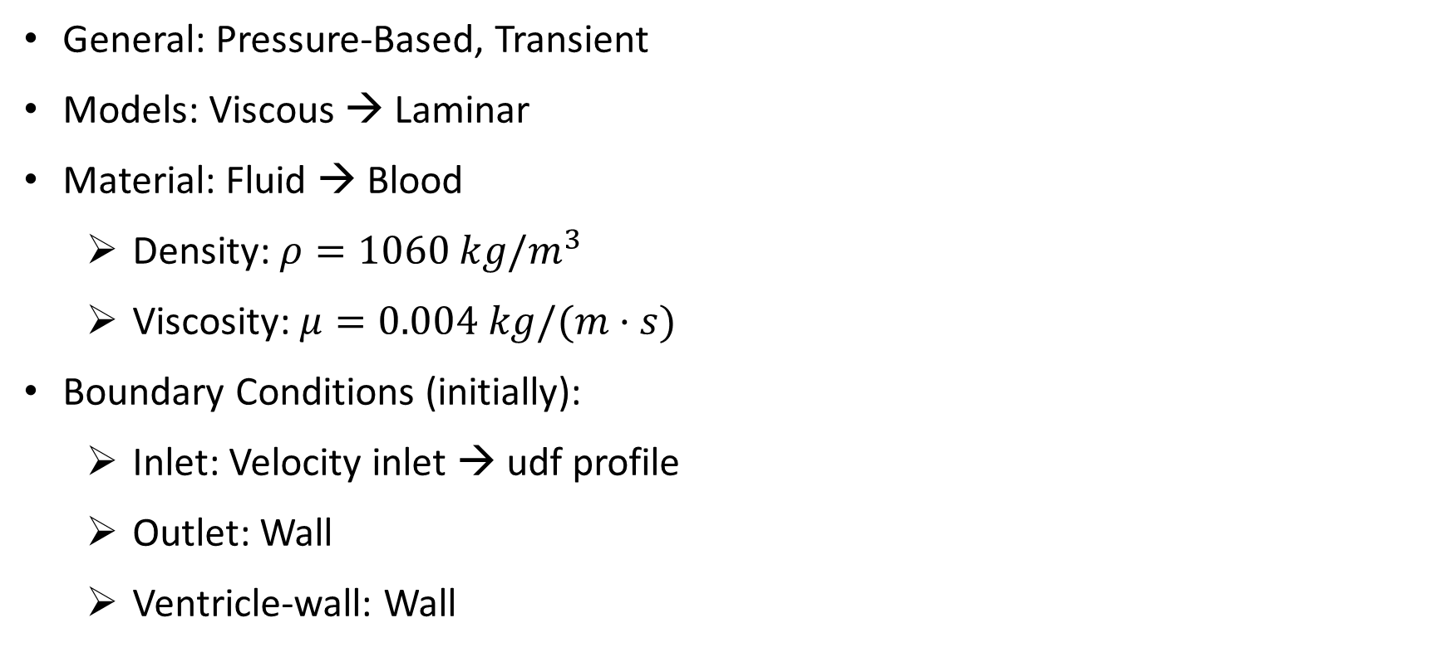
Step 2.2: Setup
General: Pressure-Based, Transient
Models: Viscous → Laminar
Material: Fluid → Blood
Density: $ρ=1060 kg/m^{3}$
Viscosity: $μ=0.004 kg/(m·s)$
Boundary Conditions (initially):
Inlet: Velocity inlet → udf profile
Outlet: Wall
Ventricle-wall: Wall
ModelFLOWs
Cardiac
Simulation Setup

Slide 8
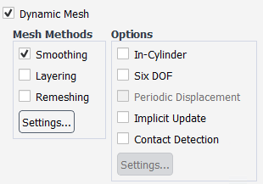
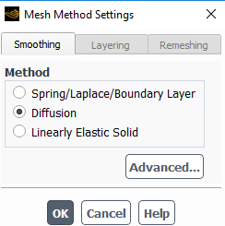
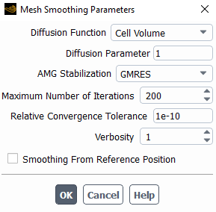
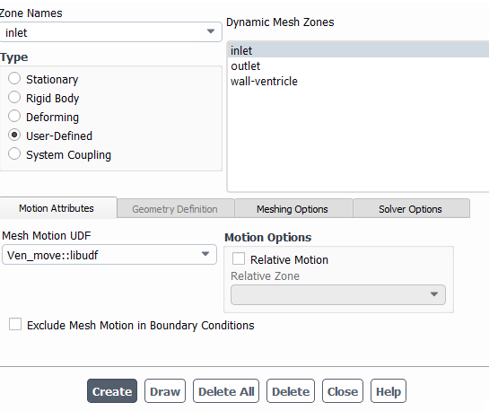
Step 2.3: Dynamic Mesh
Dynamic Mesh → Smoothing → Settings → Diffusion → Advanced
Dynamic Mesh → Events…
Read… (dynamic_events)
Defines the changes at end diastole and end systole.
Dynamic Mesh → Dynamic Mesh Zones → Create/Edit → User-Defined Type for: inlet, outlet, wall-ventricle
Check if Mesh Motion UDF/Profile: Ven_move::libudf
ModelFLOWs
Cardiac
Simulation Setup

Slide 9
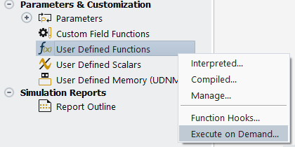
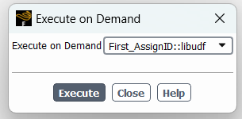
Step 3.1: Assign ID
Parameters & Customization → User Defined Functions → Execute on Demand
Select First_AssignID::libudf → Execute
File surface is created in the simulation folder
Number of nodes for each core are shown in the console
ModelFLOWs
Cardiac
Moving Wall

Slide 10
Step 3.2: Run ps_detNPts.py
Open “ps_detNPts.py” in Spyder
First execution: Answer Do you need to generate correlation file? Yes: 1. No: 0. with “1”
The reference frame ID is the number of the STL-file in the folder STL, that has been loaded and meshed with ANSYS (0).
Output: Number of Faces and allPtsNum.
First timepoint of cycle as Start FrameID (commonly 0)
Last used timepoint as End FrameID
Code creates surface_% files in a folder PTS
ModelFLOWs
Cardiac
Moving Wall

Slide 11
Step 3.3: Run ps_intNPts.py
Open “ps_intNPts.py” in Spyder
Set number of STL files on you STL folder as Total number of frames in a cycle
Set number of interpolation steps (to get timesteps for simulation) as Number of intermediate frames
Choose a temporal interpolation method between the frames
Output: number of timesteps for one cycle
Code creates udfsurface_%.asc files in folder UDFPTS → Necessary for mesh movement
ModelFLOWs
Cardiac
Moving Wall

Slide 12
Step 3.4: Adjust udf_exeDynMesh.c
Parameters & Customization → User Defined Functions → Manage
Select libudf → Unload
Delete libudf-folder
Adjust “exeDynMesh.c”
nTimeSteps: Number of timesteps = maximum index of udfsurface_%.asc (output of “ps_intNPts.py”)
allPtsNum: Number of all nodes, output of ps_detNPts.py
Compile UDF (see slide 6)
ModelFLOWs
Cardiac
Moving Wall

Slide 13
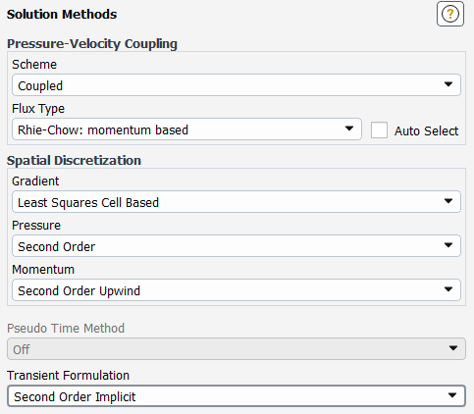
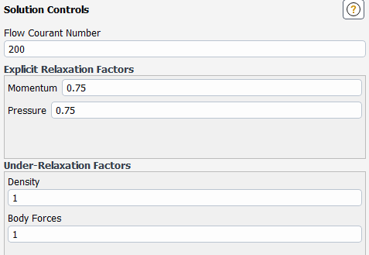
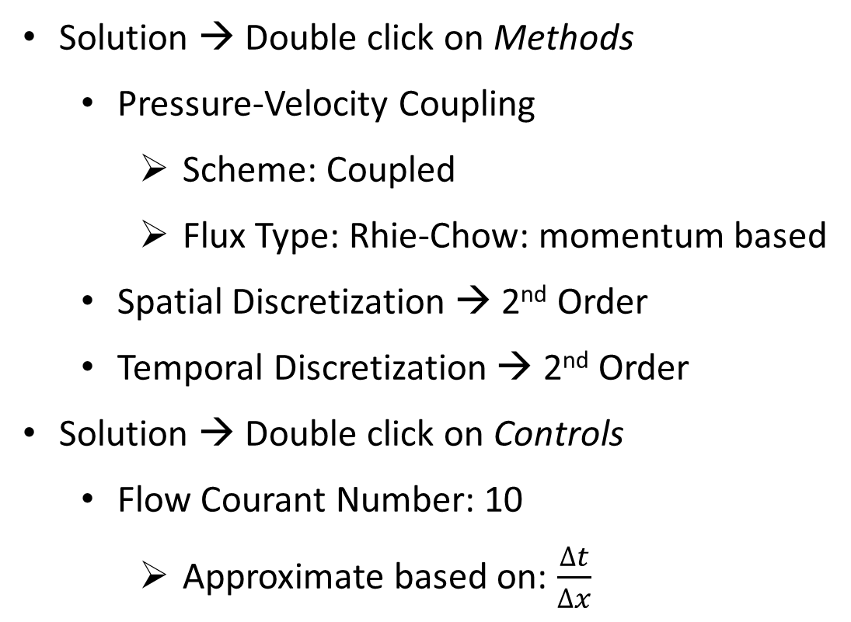
Step 4.1: Solver Methods & Controls
Solution → Double click on Methods
Pressure-Velocity Coupling
Scheme: Coupled
Flux Type: Rhie-Chow: momentum based
Spatial Discretization → 2nd Order
Temporal Discretization → 2nd Order
Solution → Double click on Controls
Flow Courant Number: 10
Approximate based on: $\frac{∆t}{∆x}$
ModelFLOWs
Cardiac
Run

Slide 14
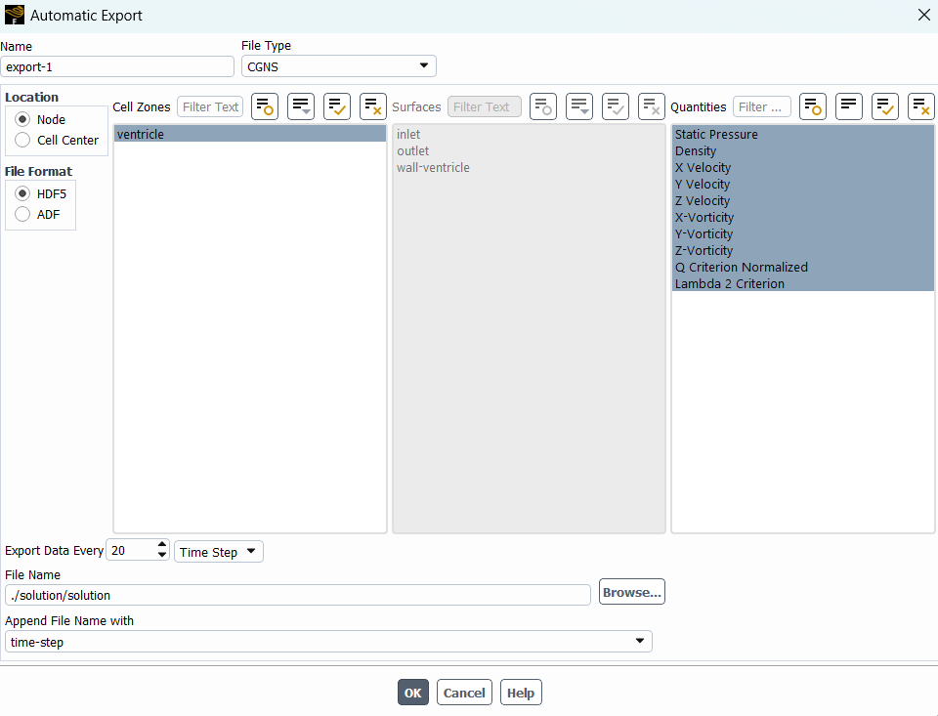
Step 4.2: Automatic Export
Solution → Double click in Calculation Activities
Automatic Export → Create
File Type: CGNS
Select ventricle as Cell Zones.
Select Quantities: Pressure, Density, Velocity, Vorticity, etc.
Export Data Every: select export frequency.
File Name: where to export and name.
ModelFLOWs
Cardiac
Run

Slide 15
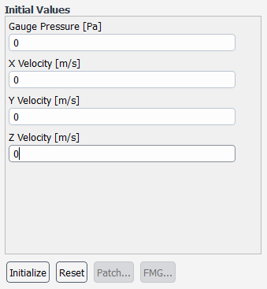
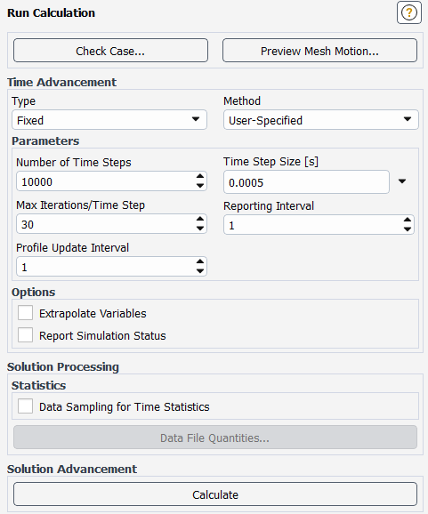
Step 4.3: Initialization & Run
Solution → Double click in Initialization
Standard Initialization → All zeros
Initialize
Parameters & Customization → User Defined Functions → Execute on Demand
Select First_loadMESH::libudf → Execute
Solution → Double click in Run Calculation
Select Time Step Size: small enough for correct resolution
Select Number of Time Steps: 5 cycles to see convergence
Select Max Iterations/Time Steps: enough for internal convergence
Run Calculation → Calculate
ModelFLOWs
Cardiac
Run

Slide 16
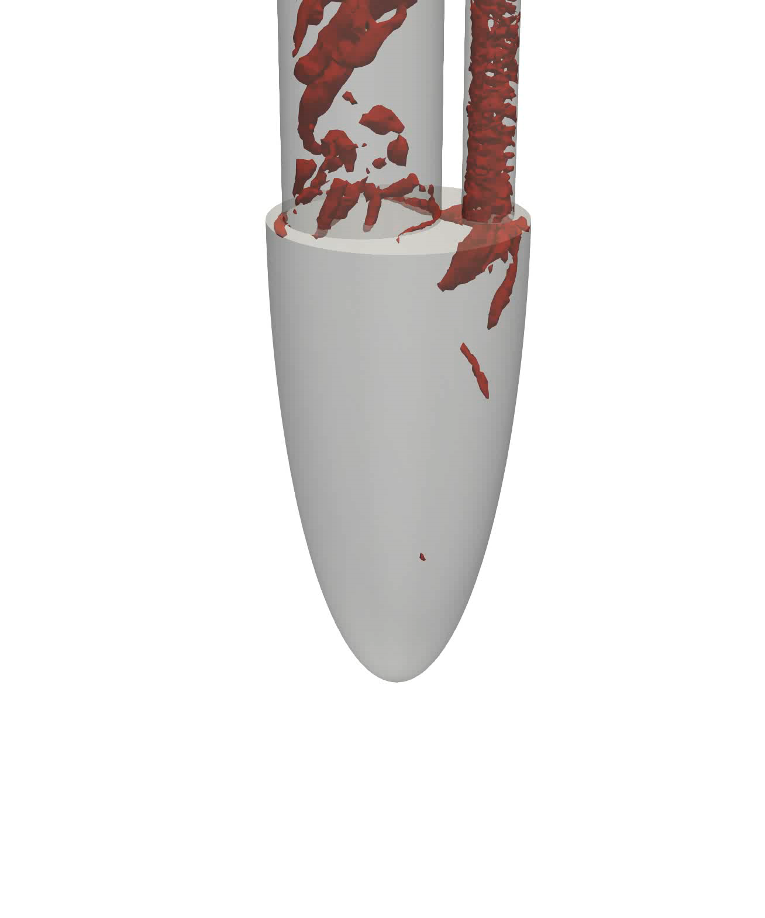
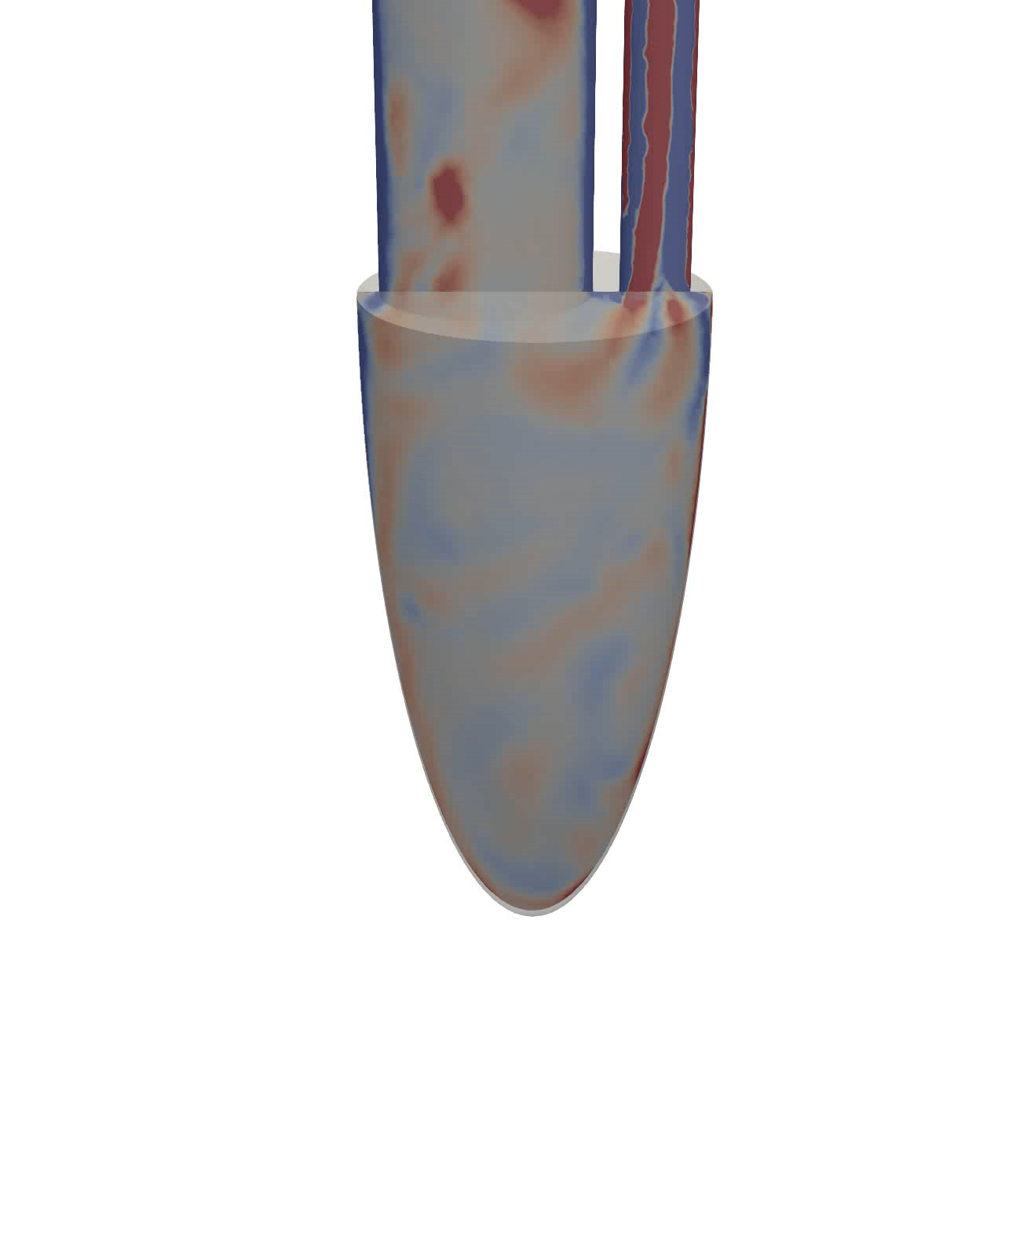
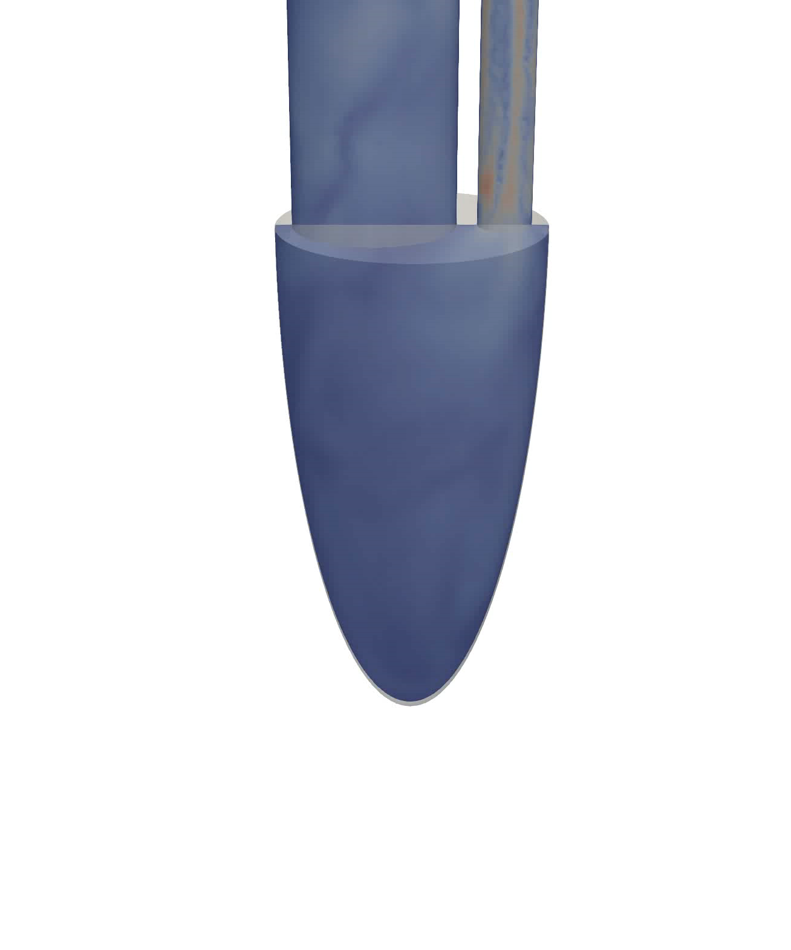
Q-Criterion
Vorticity
Velocity
Vortex ring formation, tilting, second smaller ring and outflow
Two swirls in both E and A waves of diastole and outflow in systole
Big recirculation in ventricle center, down to the apex.
ModelFLOWs
Cardiac

Slide 17


Any questions?
Look us up in our website:
https://modelflows.github.io/modelflowsapp/cardiacpathologydetection/
ModelFLOWs
Cardiac

